Slide 1
MTA Project Mohammed Sareh Assiri

Slide 2
Outline
Introduction
Analytical Approach
Data set
Clean Data
Remove Duplication
Subset Data By Time
Group By Station and Date
Total Exits Per Station
Total Entries Per Station
Conclusion

Slide 3
Introduction
The target market are commuters who use the (MTA-Stations) system since commuters are highly likely to purchase Some coffee in the morning before work. To increase this, we have to know which stations are busiest

Slide 4
Analytical Approach
•The publicly available MTA turnstile data from June to 04 September 2021 was analyzed to determine the Five stations that would garner the higher and more crowded daily commuters. Two criteria were used to pinpoint these particular commuter stations:
•High exit rate during the morning commute hours.
•High entry rate during the afternoon and evening hours

Slide 5
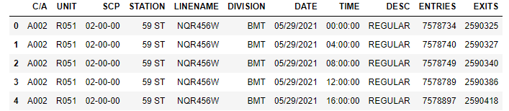
Data set

Slide 6
Clean Data

Slide 7
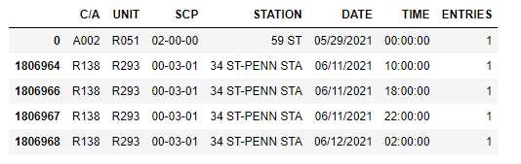
Remove Duplication

Slide 8
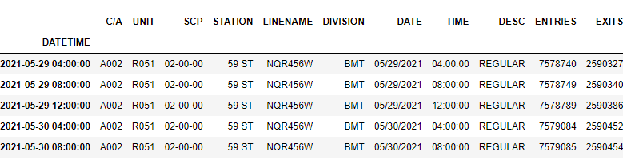
Subset Data By Time

Slide 9
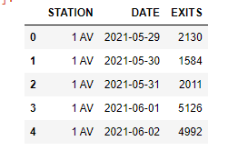
Group By Station and Date

Slide 10
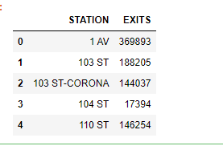
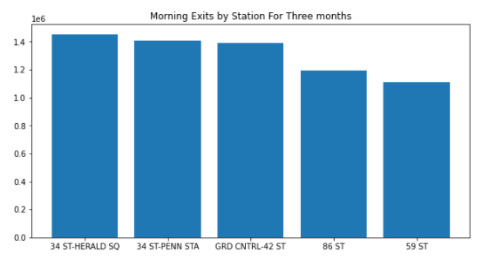
Total Exits Per Station

Slide 11
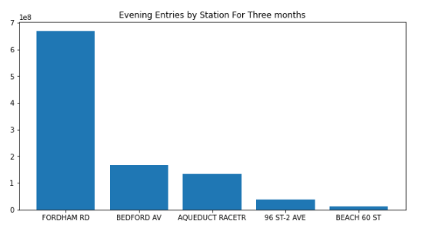
Total Entries Per Station

Slide 12
Conclusion
•After analyzing the data I conclude the following:
•We found the most Station crowded
•Best station to sell the coffee

Slide 13

Thank you

